Slide 1
Week 17 - 1 Shaders 1
5CM503 Virtual Environment Development
Dr Patrick Merritt

Slide 2
Contents
Introducing the shader graph

Slide 3
We have already been doing this!
We have done a little of this already.
But lets recap and add.

Slide 4
What are images?
Images are an array of data points (or pixels if you like)
R the amount of Red
G the amount of Green
B the amount of Blue
A the amount of Alpha (transparency)
All of these are in the range of between 0 and 1.
This represents how intense the corresponding value should be
0 is fully off, 1 is fully on, and 0.5 is halfway between.
Mixing all of these allows us to produce a range of colours and transparency.

Slide 5
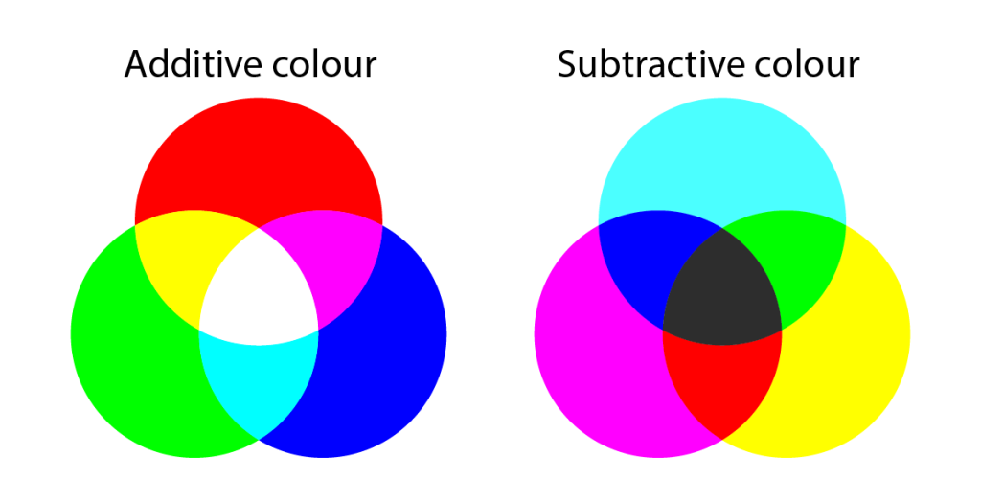
Additive vs Subtractive

Slide 6
Data can be manipulated!
As all the data points are stored as numbers, we can manipulate them using maths to create different effects.
This in essence is what a shader does, alters the datapoints using maths.

Slide 7
Data sources
Where do the numbers come from?

Slide 8
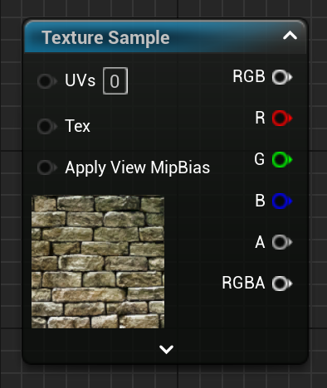
Texture
Creates a texture we can sample for information.
R G B, and A can be sampled together or individually.

Slide 9
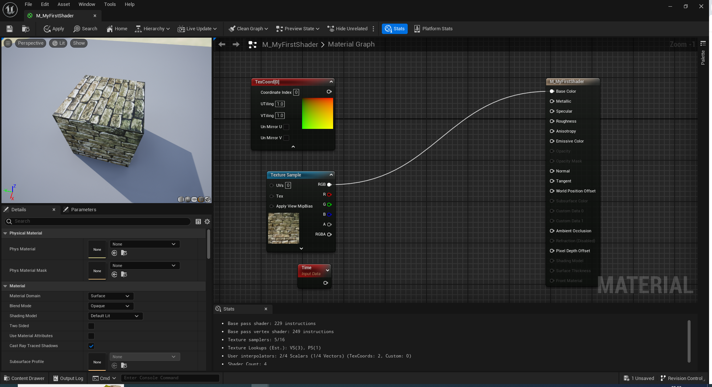

Slide 10
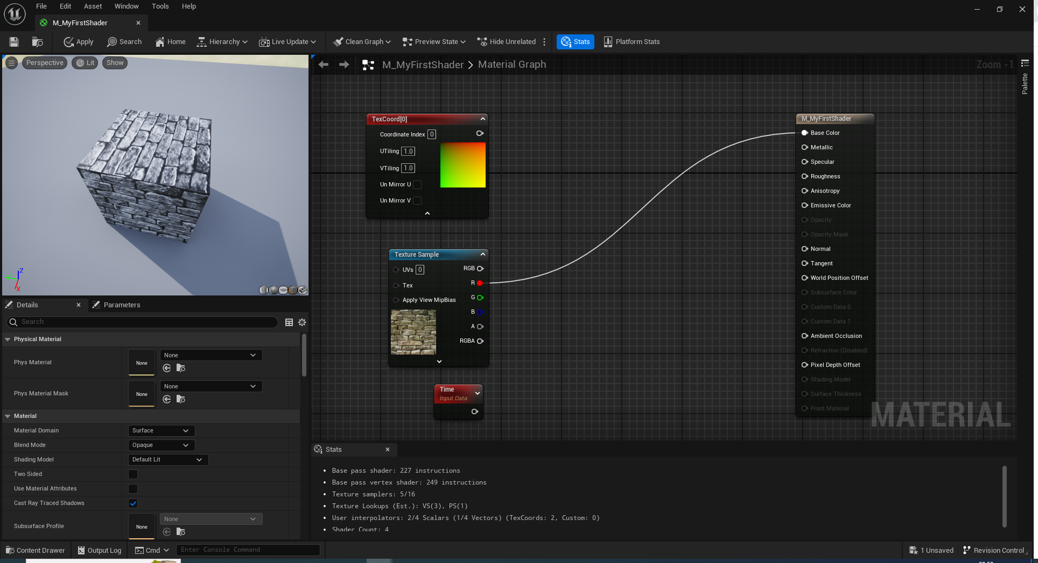
Red is not red in colour; it’s the red information layer

Slide 11
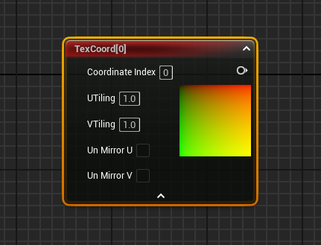
The TexCoord (UV) Node
Brings in the texture coordinates into the graph
U is the horizontal coordinate (left to right) (red)
V is the vertical coordinate (up down) (green)

Slide 12
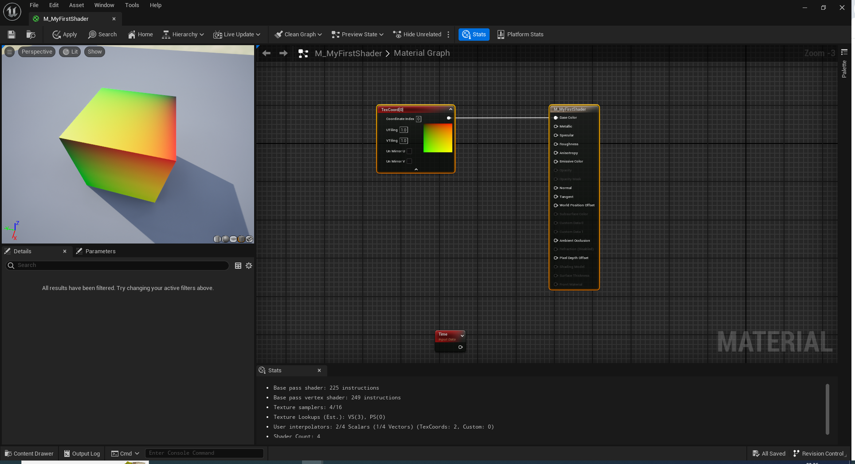

Slide 13
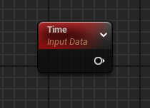
Time
A numerical value that consistently counts upwards
Allows us to change effects over time.

Slide 14
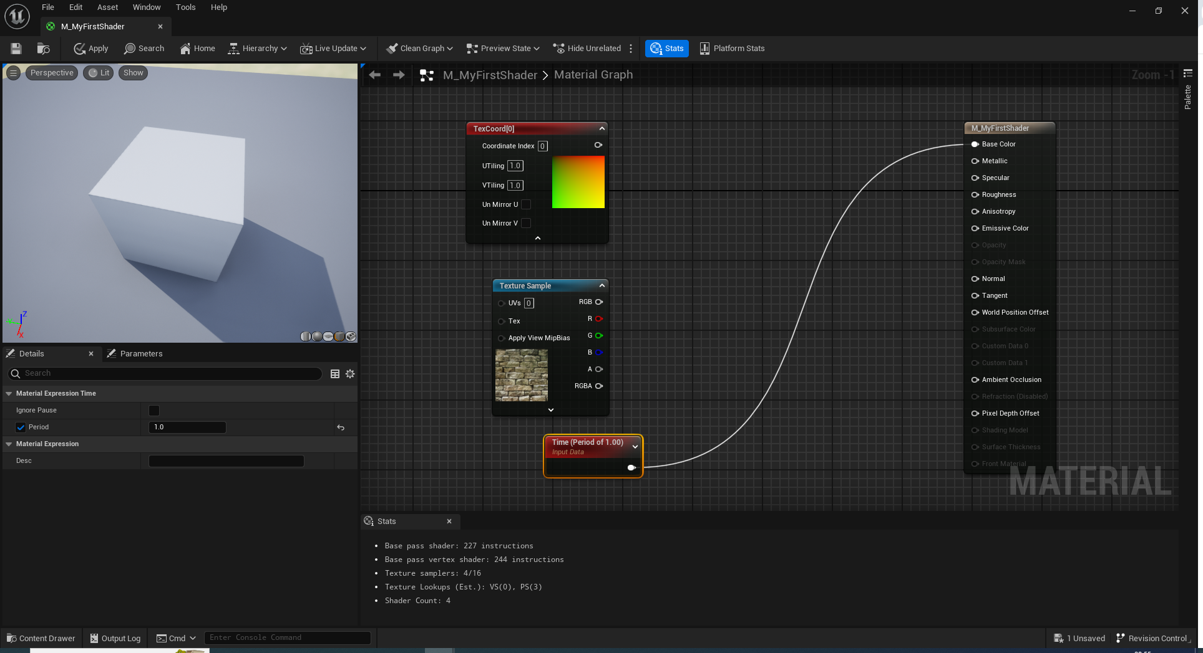

Slide 15
Manipulators
Changing the data.

Slide 16
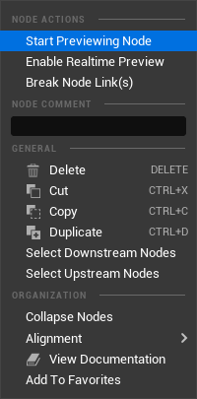
Preview
It’s a good idea to learn how the preview works as it allows us to see the current state of the maths we are doing.
Right-click any node and select Start Previewing.
Don’t forget to turn off to return to the final calculation!

Slide 17
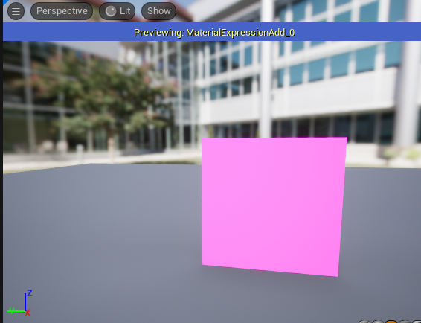
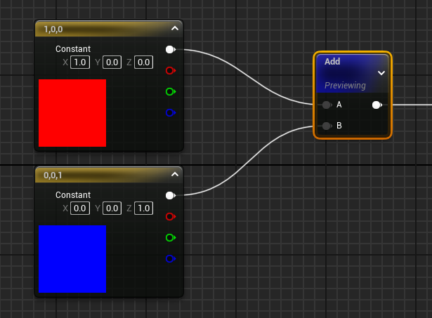
Add node. Adds A and B together

Slide 18
Add node.
Notice we don’t get any shading here as we are viewing the mathematical output, lighting is applied later.

Slide 19
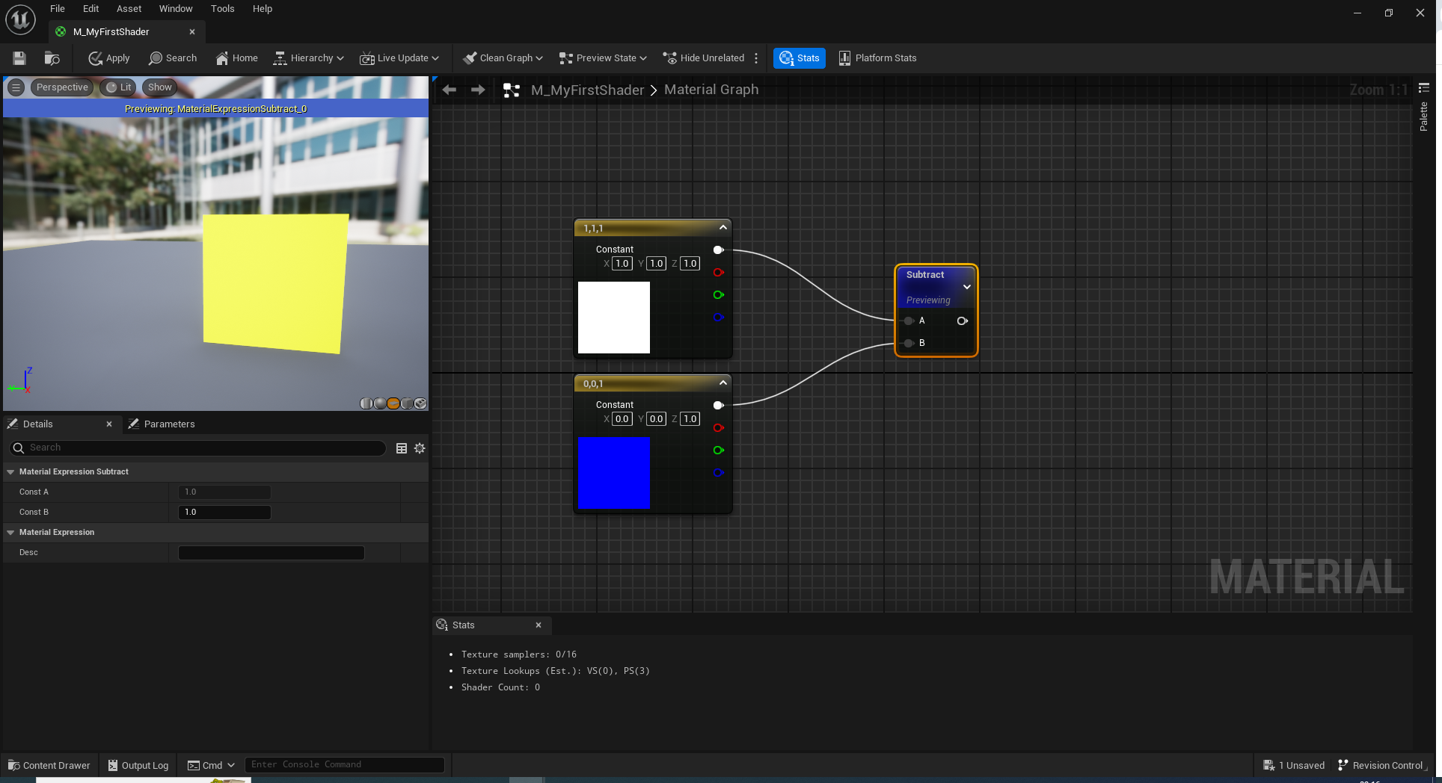
Subtract, Take B away from A

Slide 20
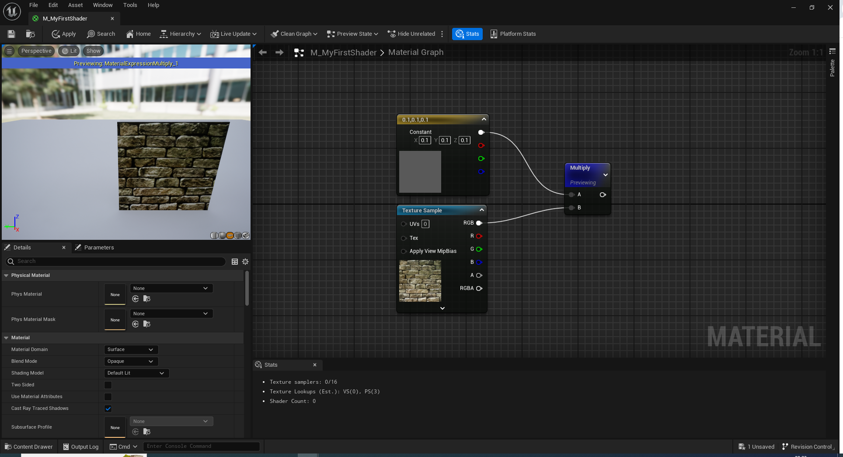
Multiply A times B

Slide 21
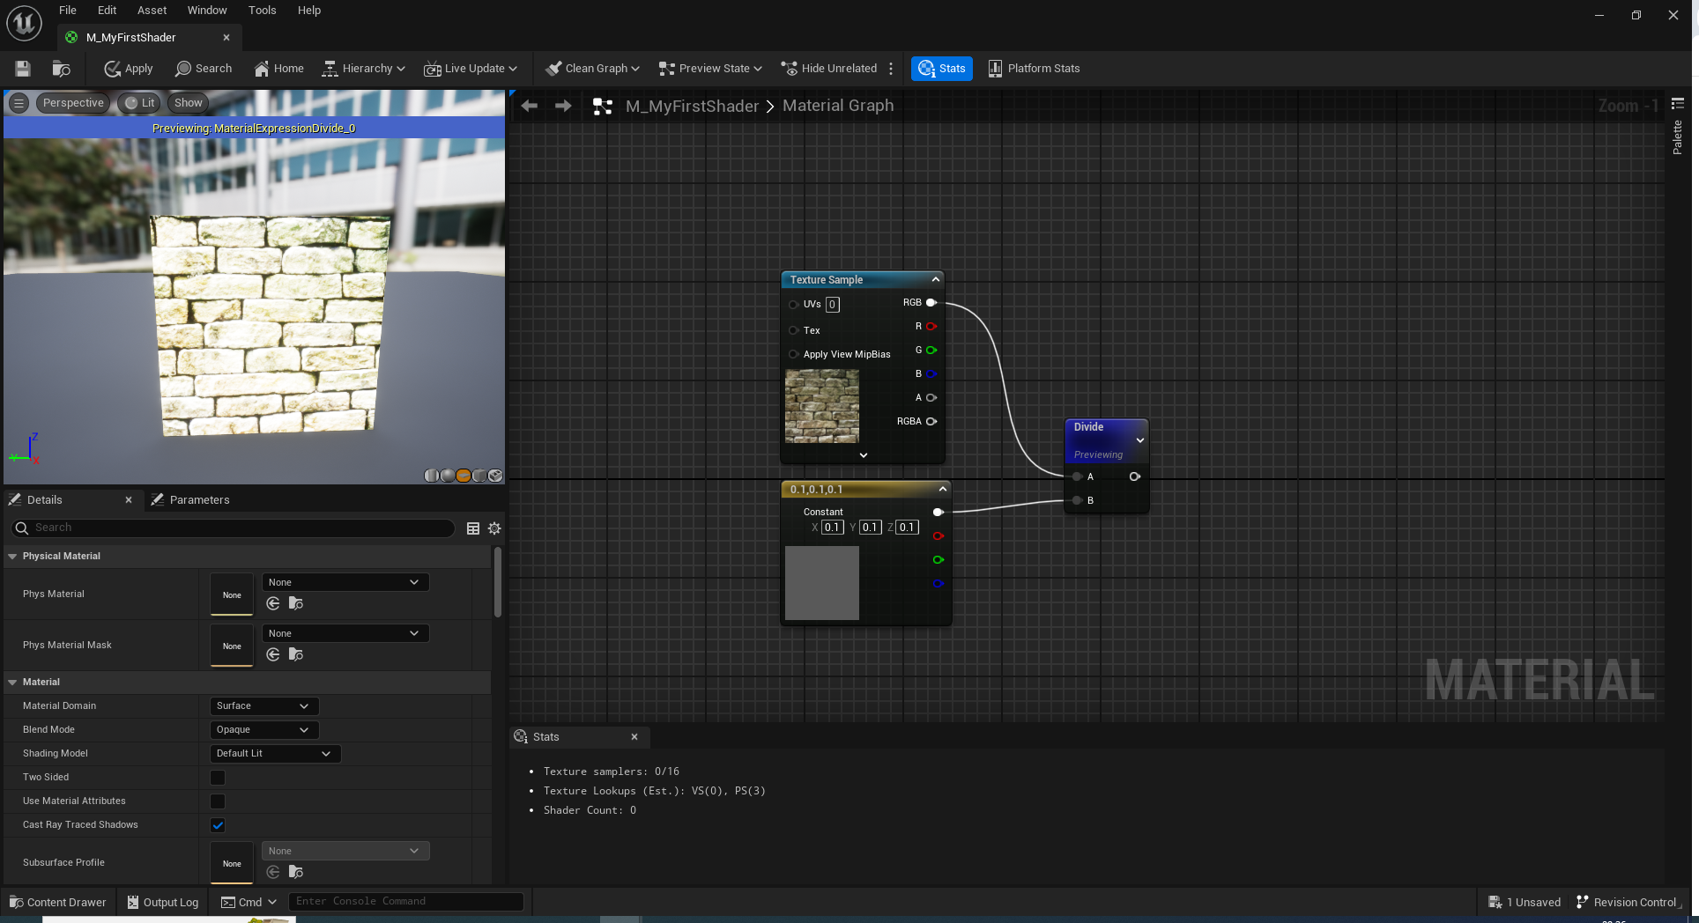
Divide, A divided by B

Slide 22
Costs…
Each manipulation you perform has a cost in terms of performance.
Based on the complexity of the operation.
Add and multiply are cheap.
In fact, doing both at the same time is free!
Divide is very expensive.

Slide 23
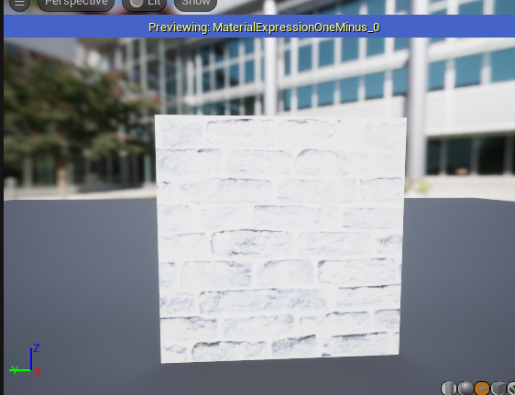
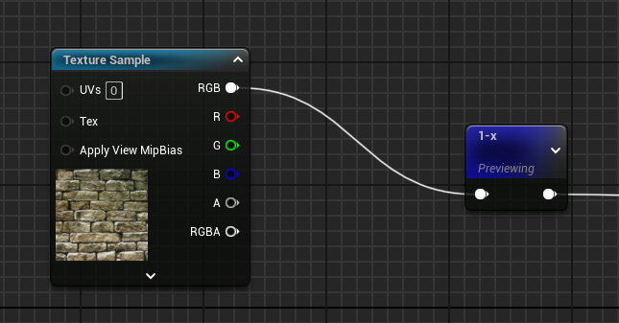
One minus, inverts a range

Slide 24
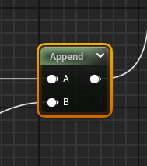
Append
Combine values to make a new vector.
Value x Append Value y = vector x,y

Slide 25
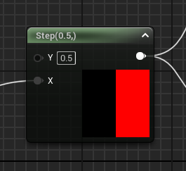
Step
Returns a value of either 0 or 1 based on a reference value (Y).
If the value is greater than Y, set it to 1; otherwise, 0.
So a horizontal gradient (0 – 1) returns a 50 – 50 split down the middle.

Slide 26
Simple effects
Simple shader effects

Slide 27
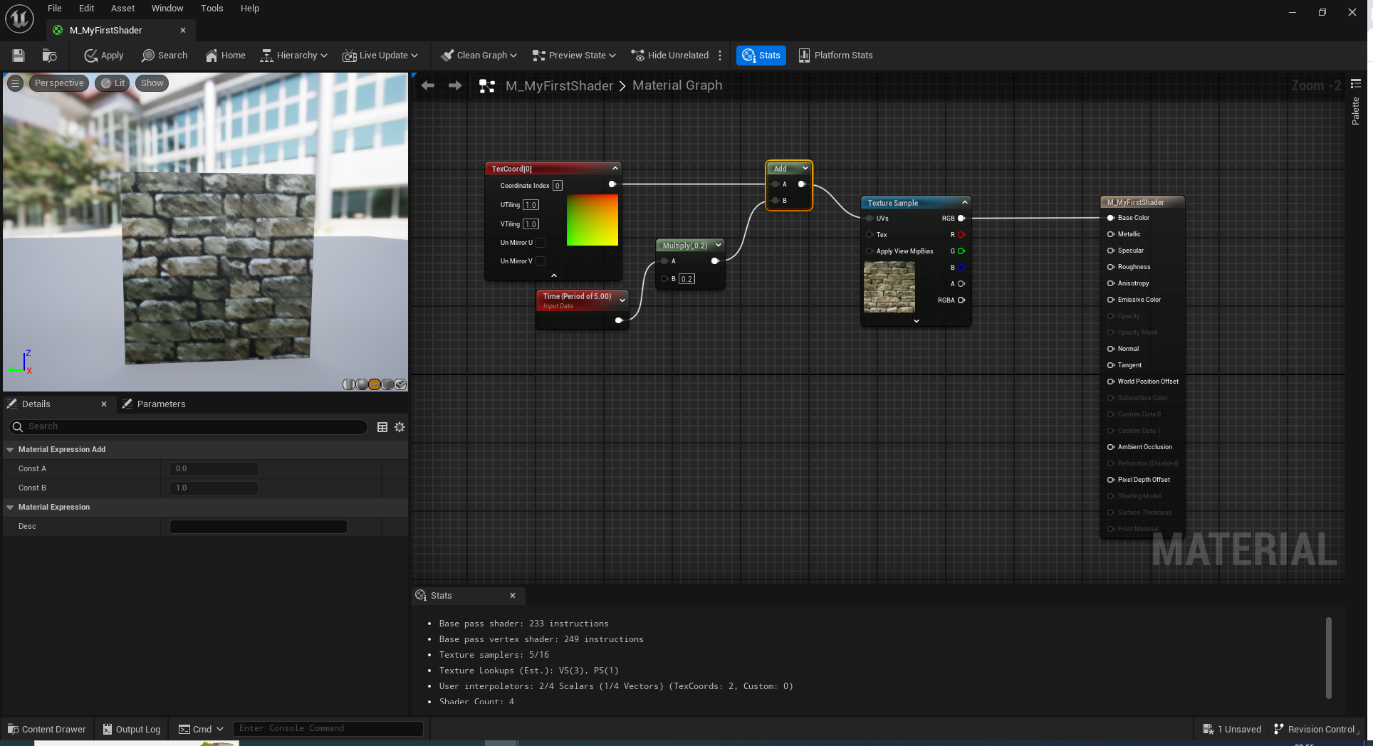
Scrolling u and v

Slide 28
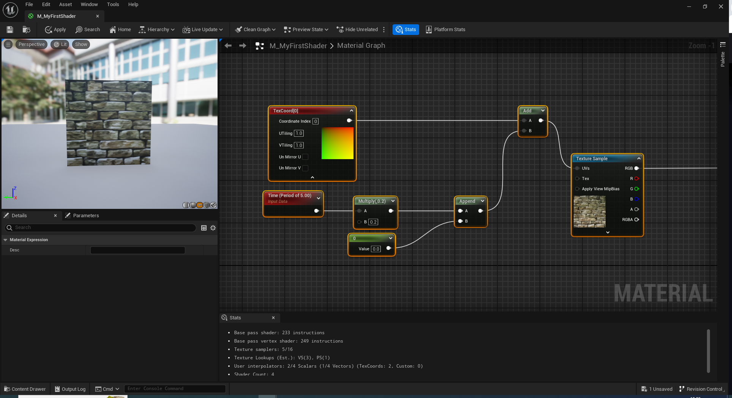
Single axis scroll

Slide 29
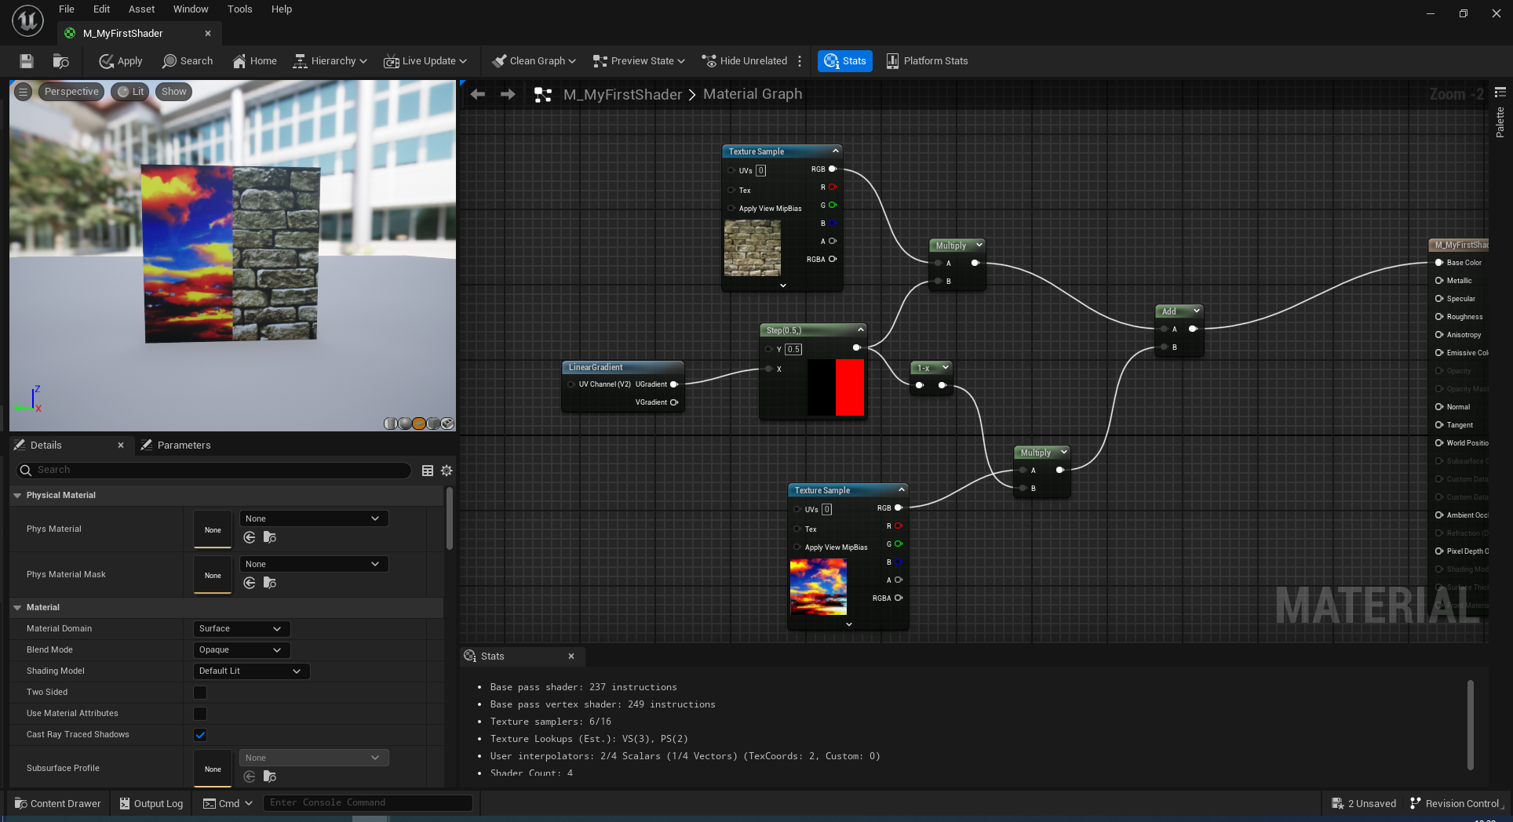
Splitting Textures

Slide 30
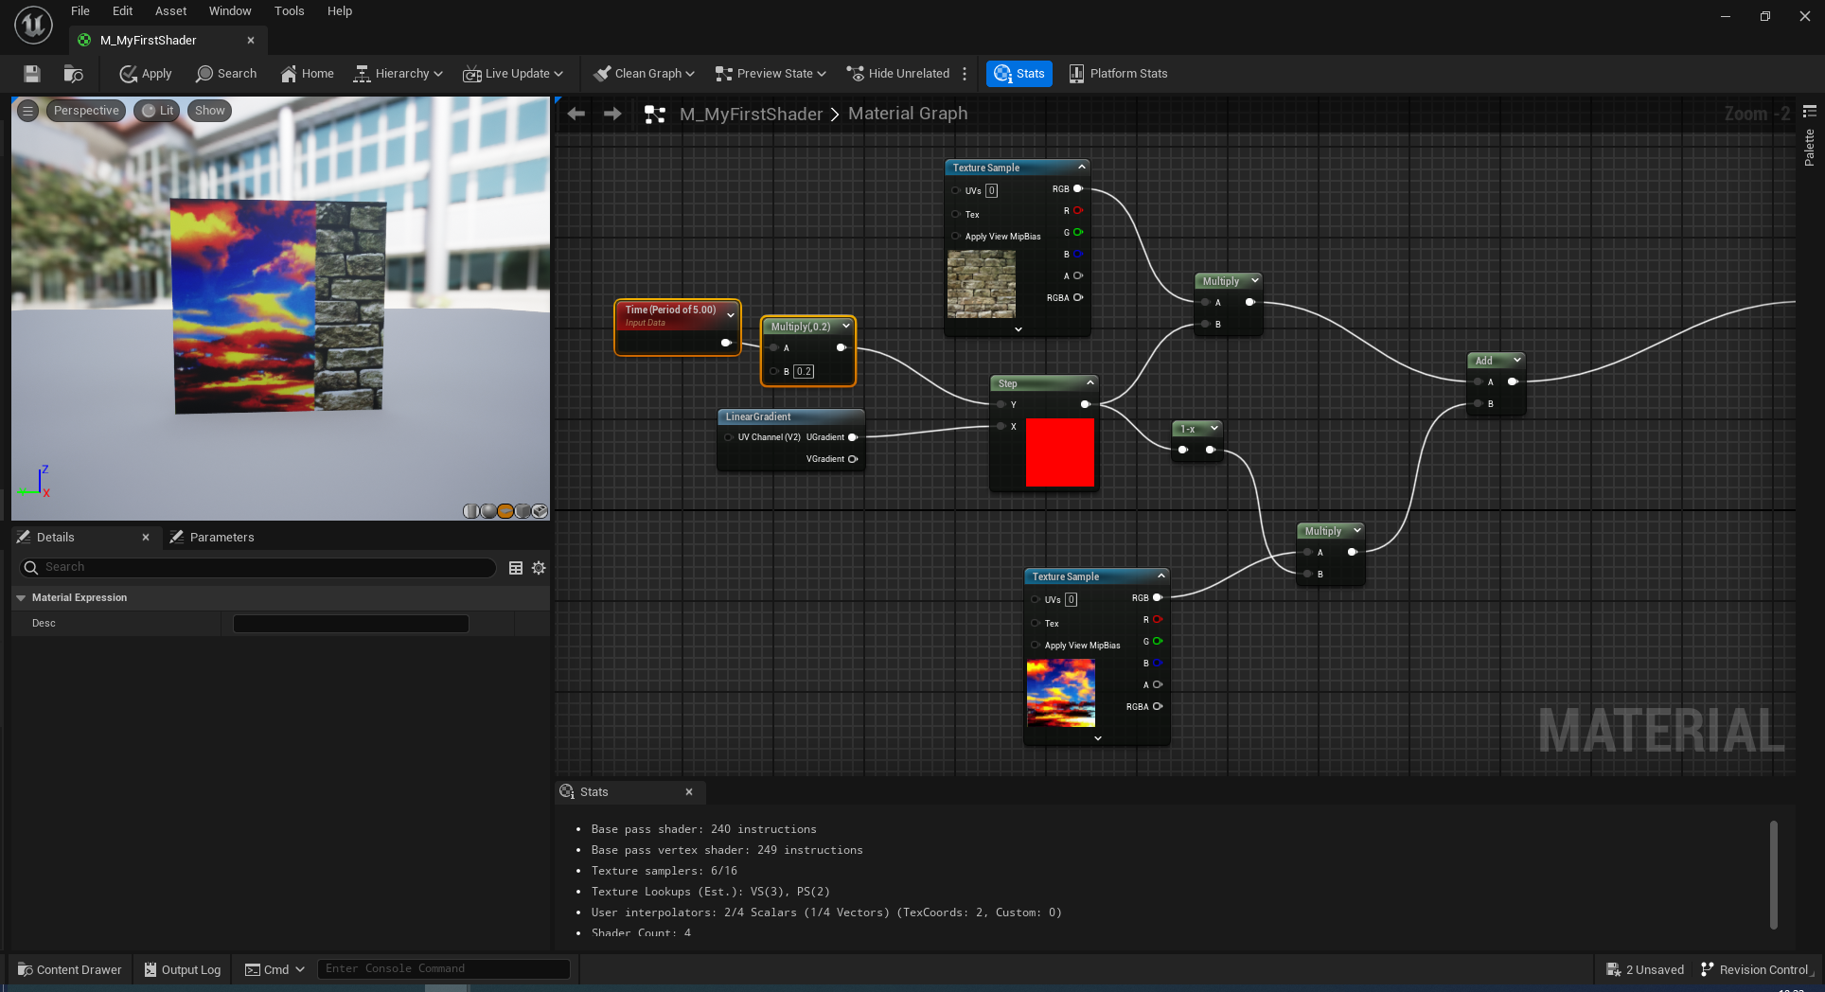
Swiping textures

Slide 31
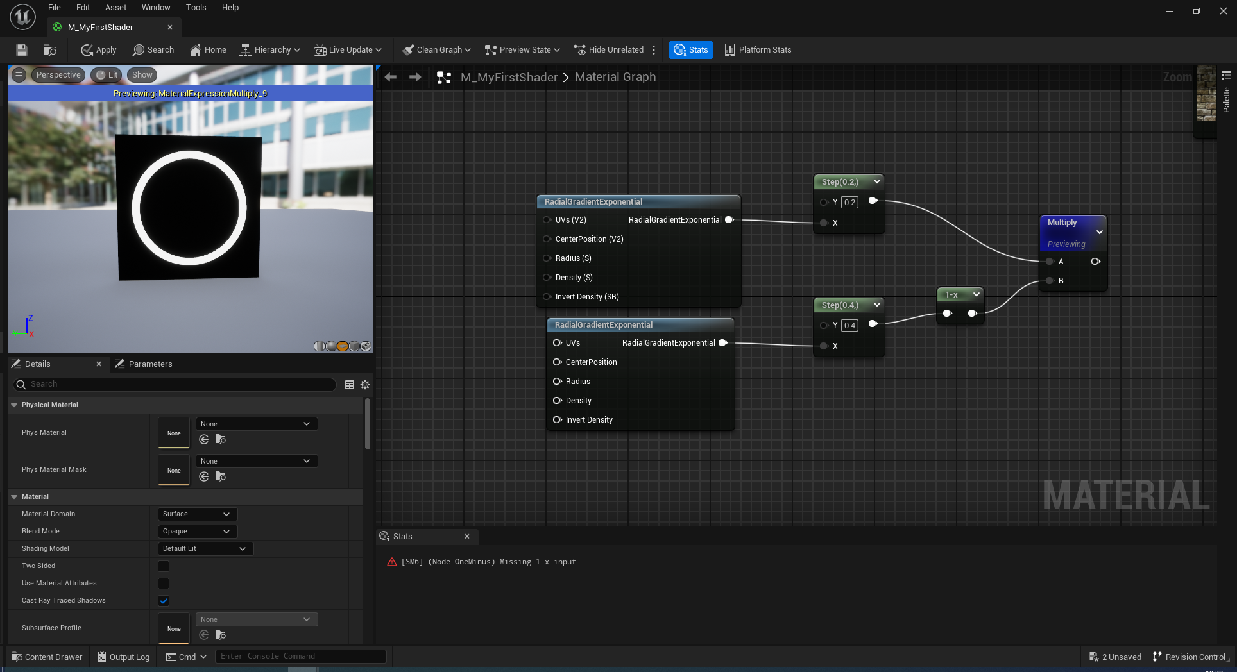
Masks, creating black and white shapes

Slide 32
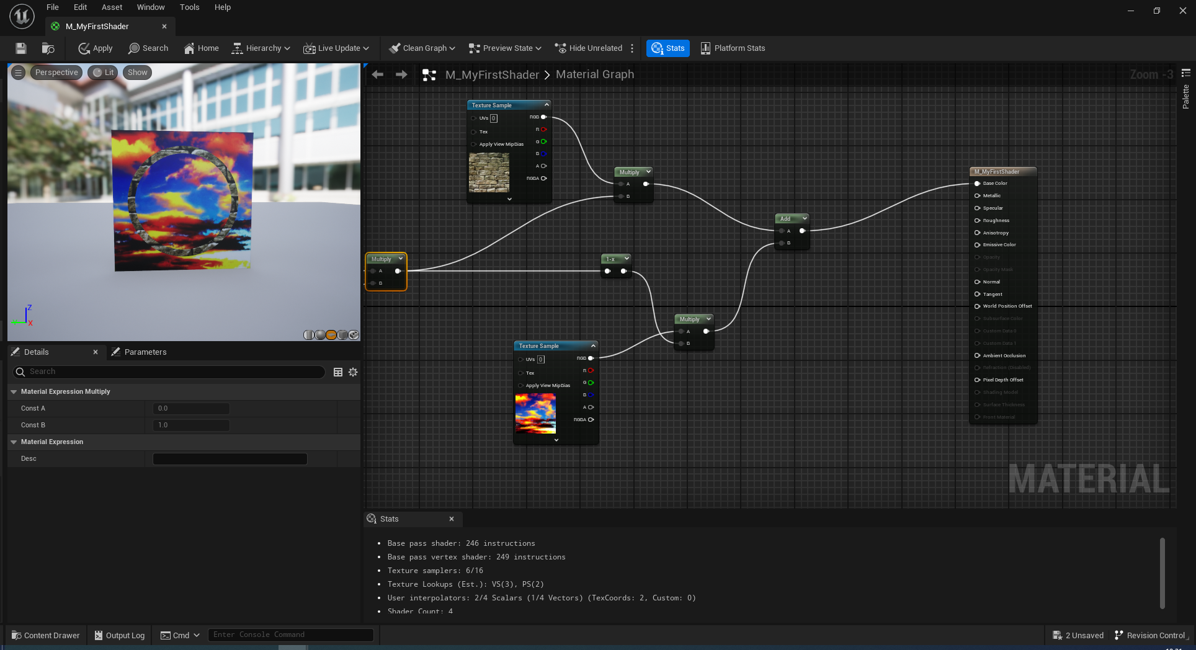
We can do this…

Slide 33
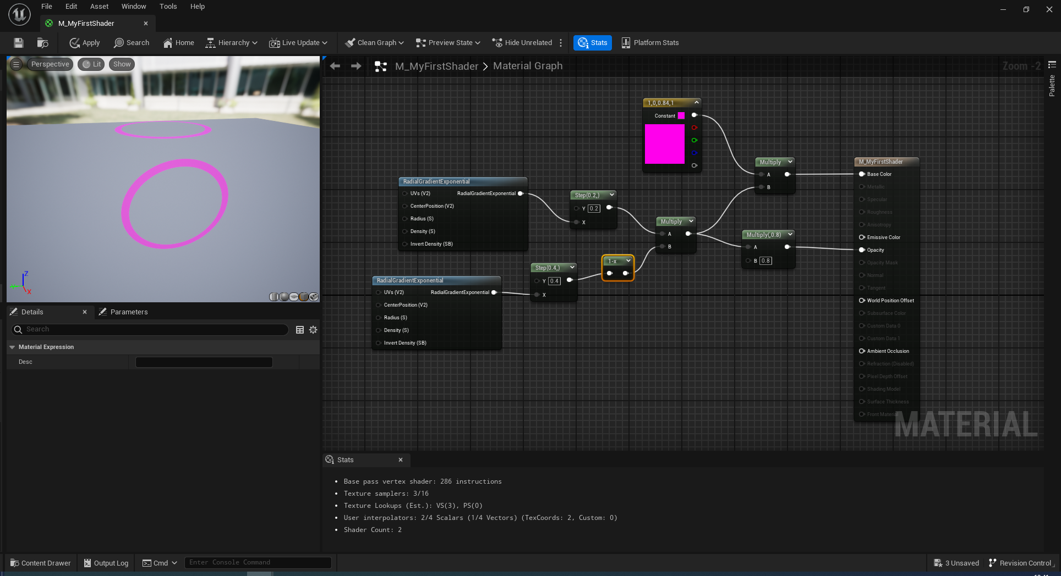
Or more importantly…. This

Slide 34
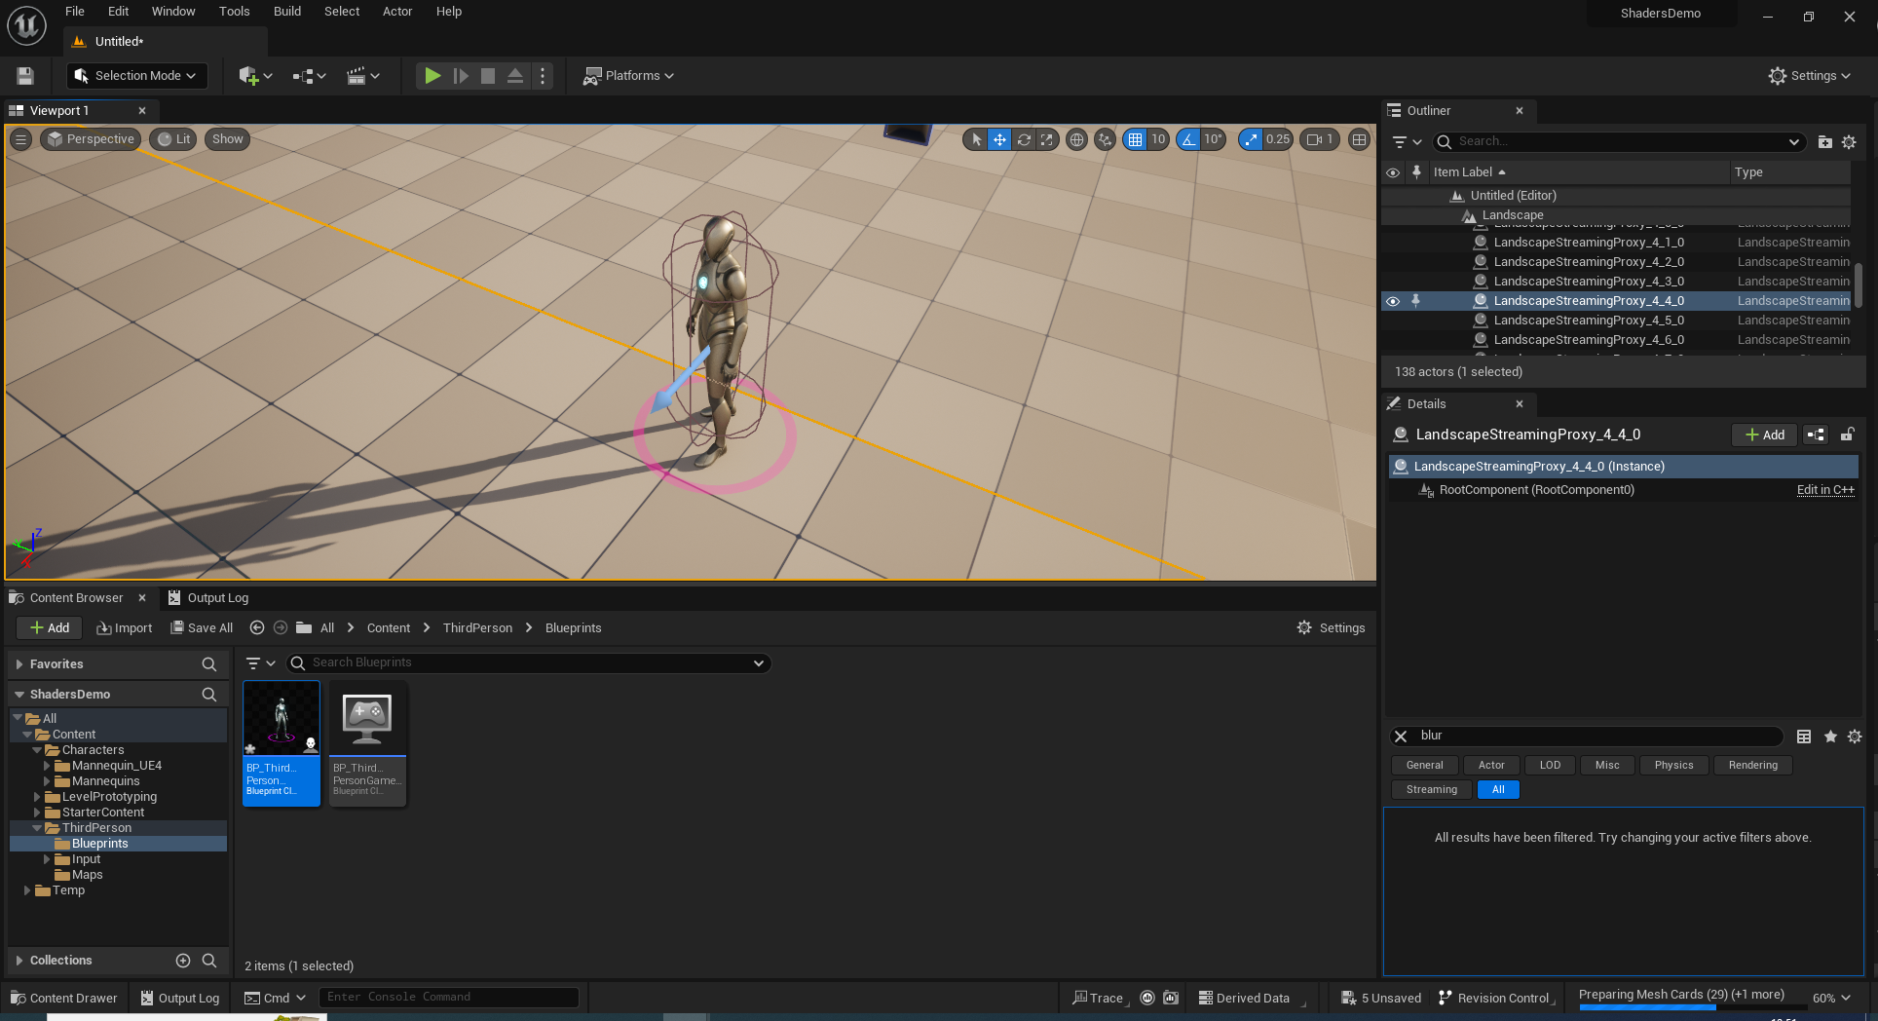
Specifically this…

